Slide 1
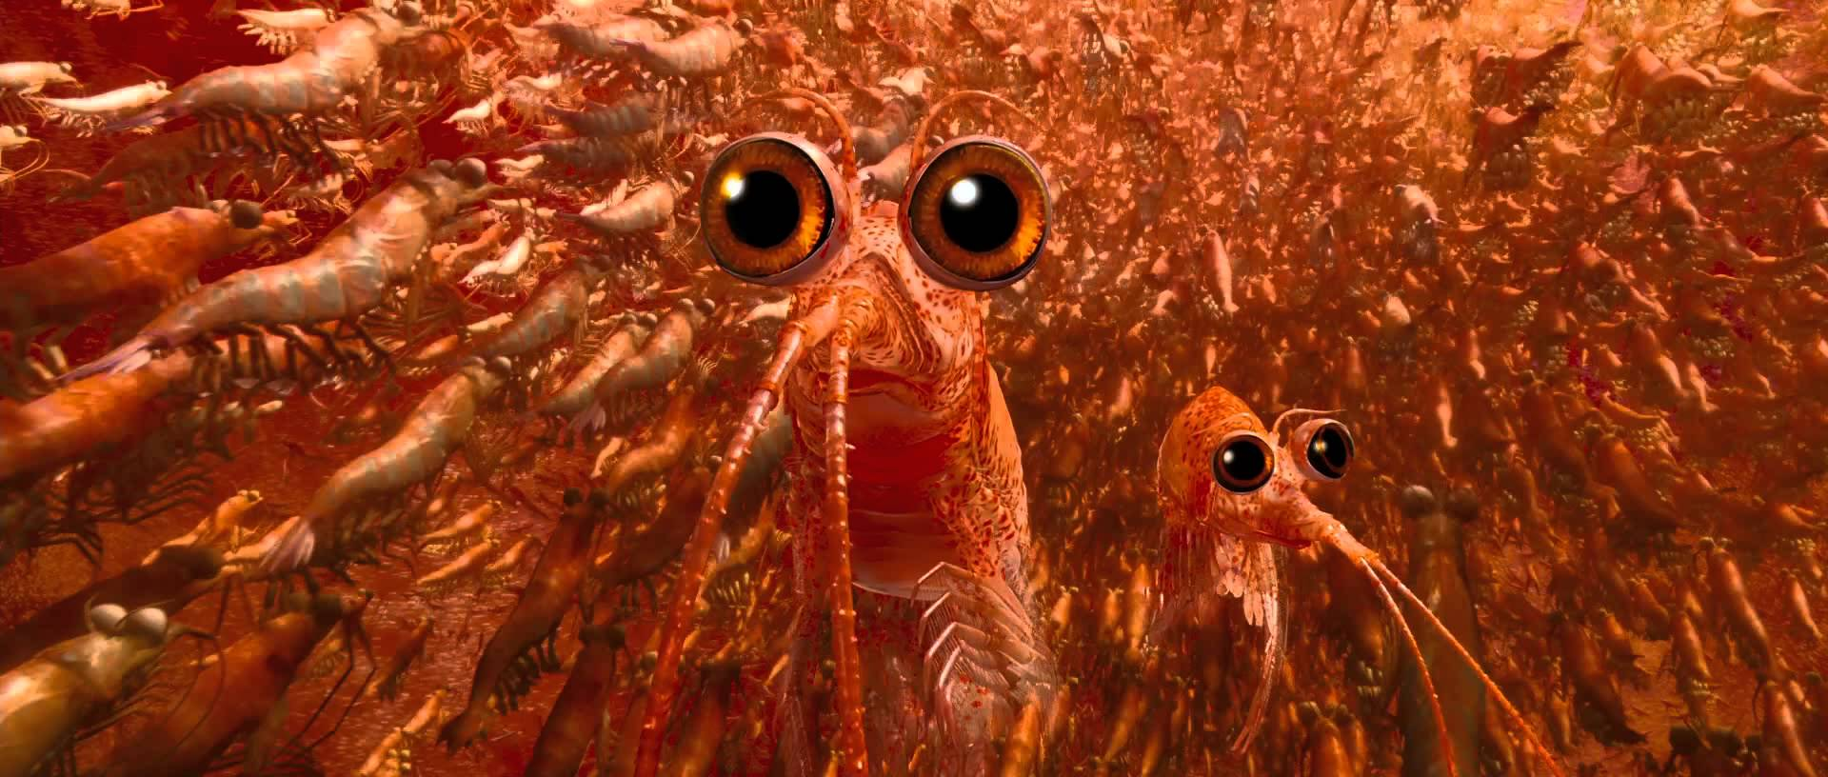
The Krillians
Jules Bachmann, Anna Jaeggi, Felix Sarnthein, Laura Wülfroth

Slide 2
Table of Contents
Our Goals
The model
Implementation
Results
Outlook

Slide 3
Our goals
Implementation of a krill swarm
Analyse the swarm reacting on escaping krill
→ After what percentage of escapists does the swarm follow?

Slide 4
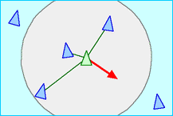
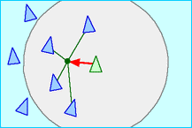
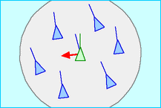
Boids model
Force Components: Separation, Cohesion, Alignment

Slide 5
The escapists
Move towards target vector
Still influenced by other krills

Slide 6
Implementation
Autonomous Character Model by Craig Reynolds
agent-based model for animations
autonomous individuals follow a set of rules
restricted perception of environment
impression of reproducing a behaviour

Slide 7

Implementation
Non-Social Behaviours
seek a target
flee a target
wander randomly but naturally → seek a random target in front
individuals respond to a target

Slide 8
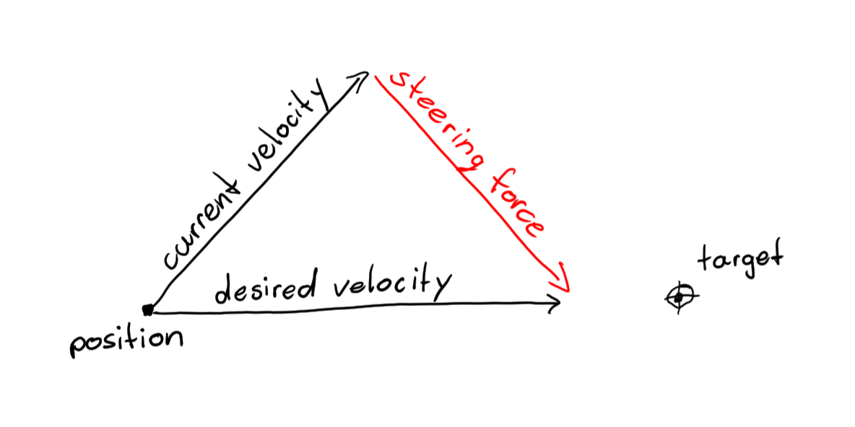
Implementation
The Force Model
key concept
makes animations feel natural
allows for modular approach
multiple forces are added together
agility is controllable
steering_force = desired_velocity - current_velocity
current_velocity = current_velocity + steering_force
position = position + current_velocity

Slide 9
Implementation
But most importantly: Usefull abstraction of steering behaviour
→ every behaviour only needs to specify its desires

Slide 10
Implementation
Non-Social Behaviours within the Force Model
behaviour_x | computeDesire( … )
seek | desired_velocity = + (target – position);
flee | desired_velocity = - (target – position);
wander | desired_velocity = + (target* - position);
steering_force = behavior_x( position, velocity, environment){
desired_velocity = computeDesire(...);
steering_force = computeForce(velocity, desired_velocity);
return steering_force;
}

Slide 11
Implementation
Social Behaviours within the Force Model
behaviour_x | computeDesire( … )
cohesion | desire = + (neighbor – position);
separation | desire = - (neighbor – position); desire = desire / norm(desire)^2;
alignment | desire = neighbor_velocity;
neighbors = rangesearch( positions, radius);
for all neighbors i
desires[i] = computeDesire(...);
desired_velocity = mean(desires);

Slide 12
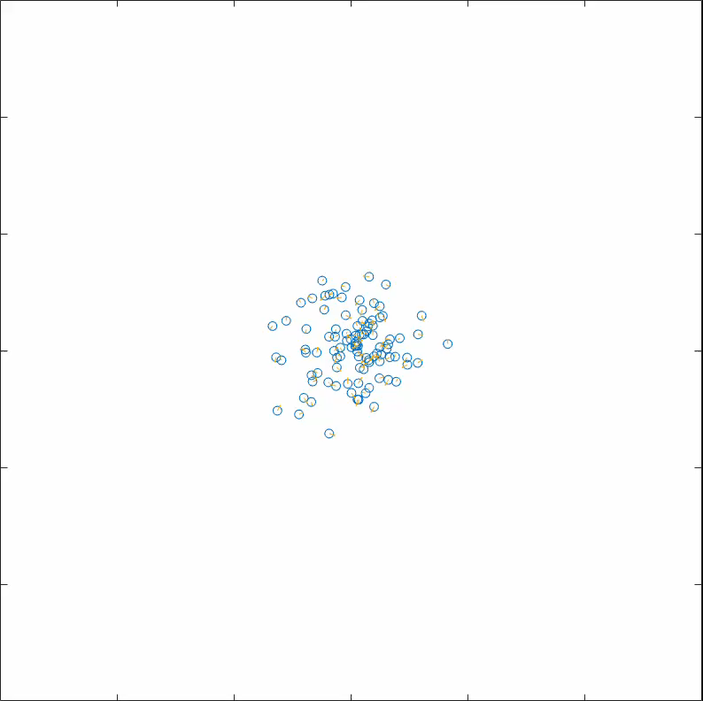
Implementation

Slide 13
Implementation of the escapists
Vector A: target vector and steering force
Combinate with normal influences
Target vector
Max Steering force
New vector
Current velocity

Slide 14
Computation of the results
Following target vector
Closeness to escapists
Computation every single simulation step
Target vector
- Current vector
ErrorMargin

Slide 15
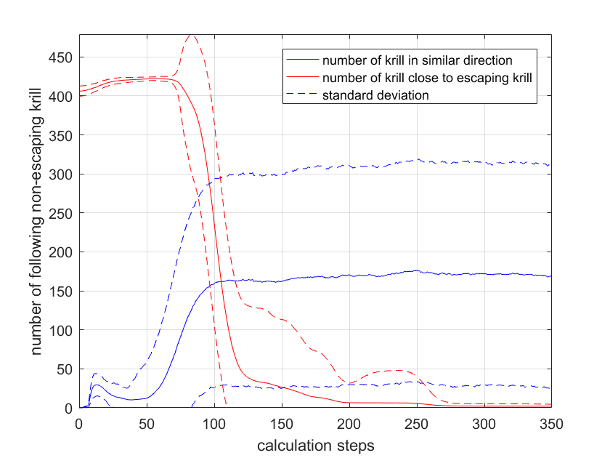
Results
125 calculation steps
Results of 15% escaping krill and a target vector [0,1]

Slide 16
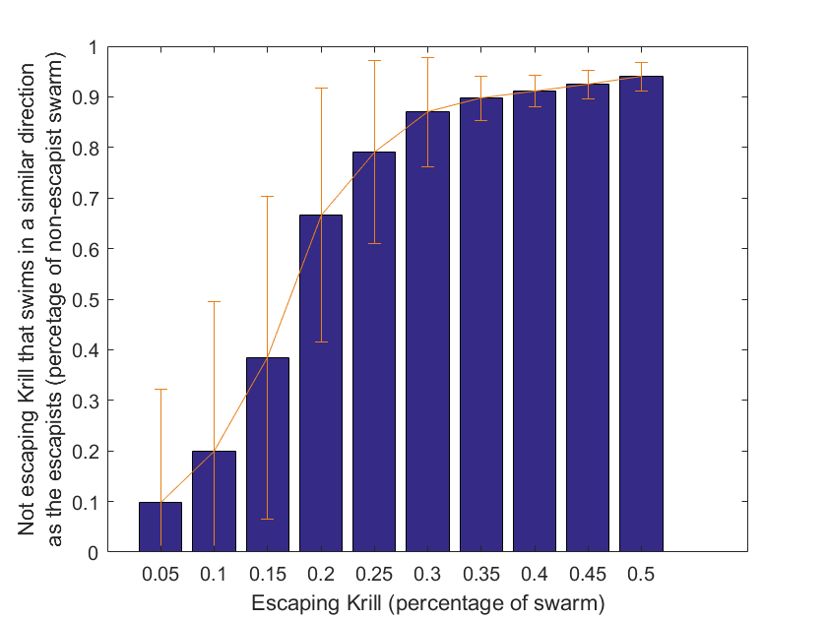
Results

Slide 17
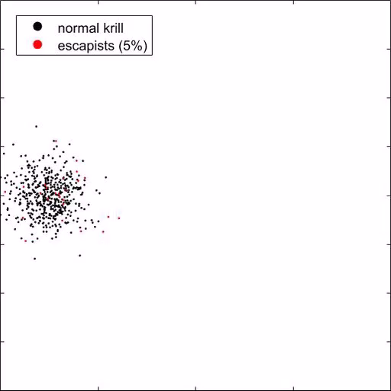
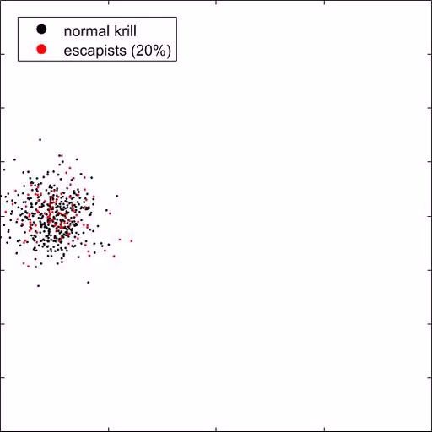
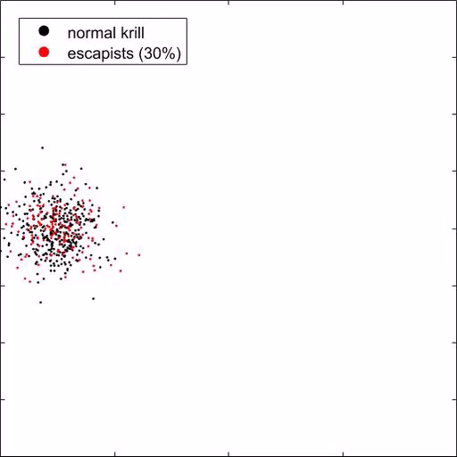
Results

Slide 18
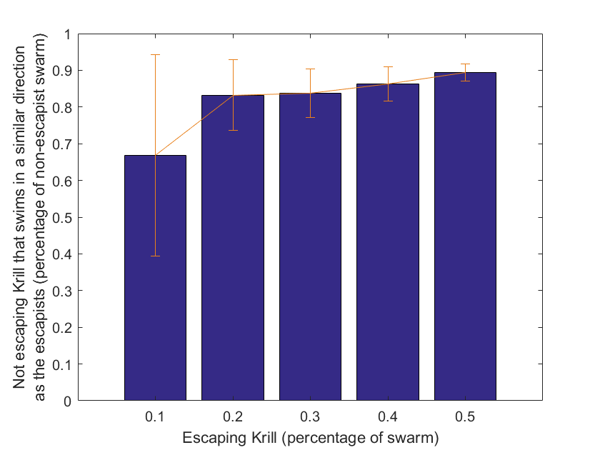
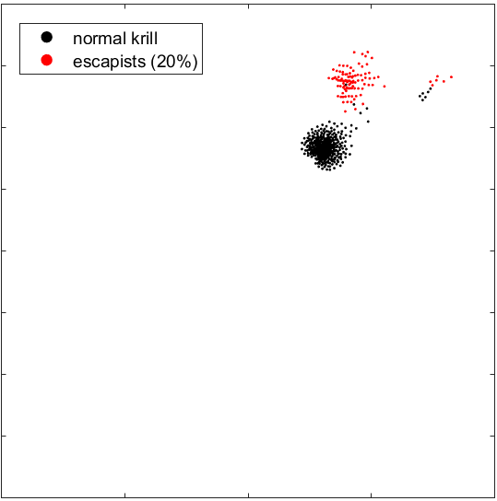
Results

Slide 19
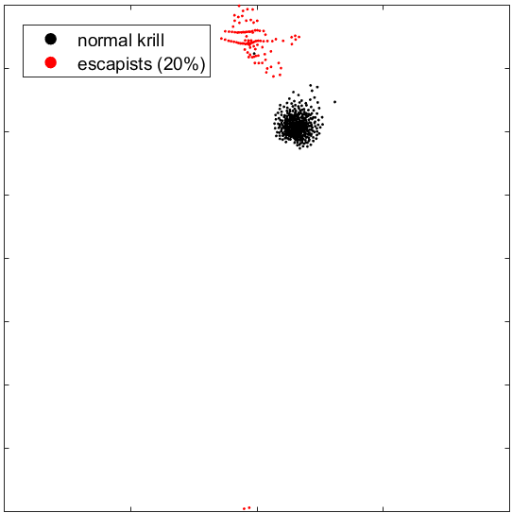
Results

Slide 20
Summary and Outlook
After what percentage of escapists does the swarm follow?
30% for [0,1], ~20% for [1,1]
Problem: “similar” vector (the range)
Further simulations:
Swimming direction of the swarm
Position of the escapists
Current

Slide 21
Questions?

